Slide 1


Play with words

Slide 2



Project Introduction
App Name: Play With Words
Integrated Design Environment: Android Studio
Targets:
Practicing new words
Interesting and Effective

Slide 3






Meet Our Team
Thanh Huong
Phu Duy
Minh Toan
Leader
Developer
Manager
Ứng dụng được phát triển bởi đội ngũ công nghệ thông tin tài năng, kiên trì
và không ngừng học hỏi.
Duc Huy
Quang Huy
Developer
Developer

Slide 4






About App Game
Sign up
Sign in
Menu
Let’s play
Share result
Log out

Slide 5
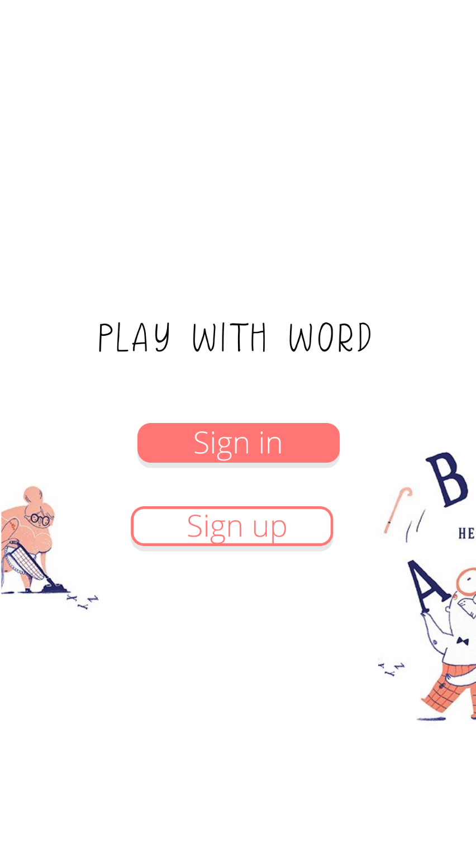
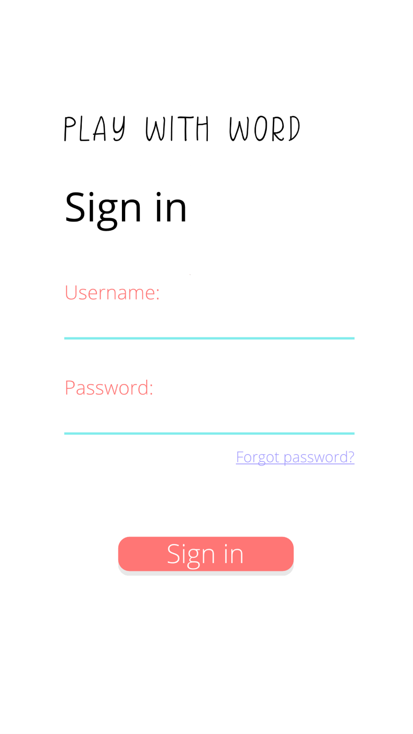
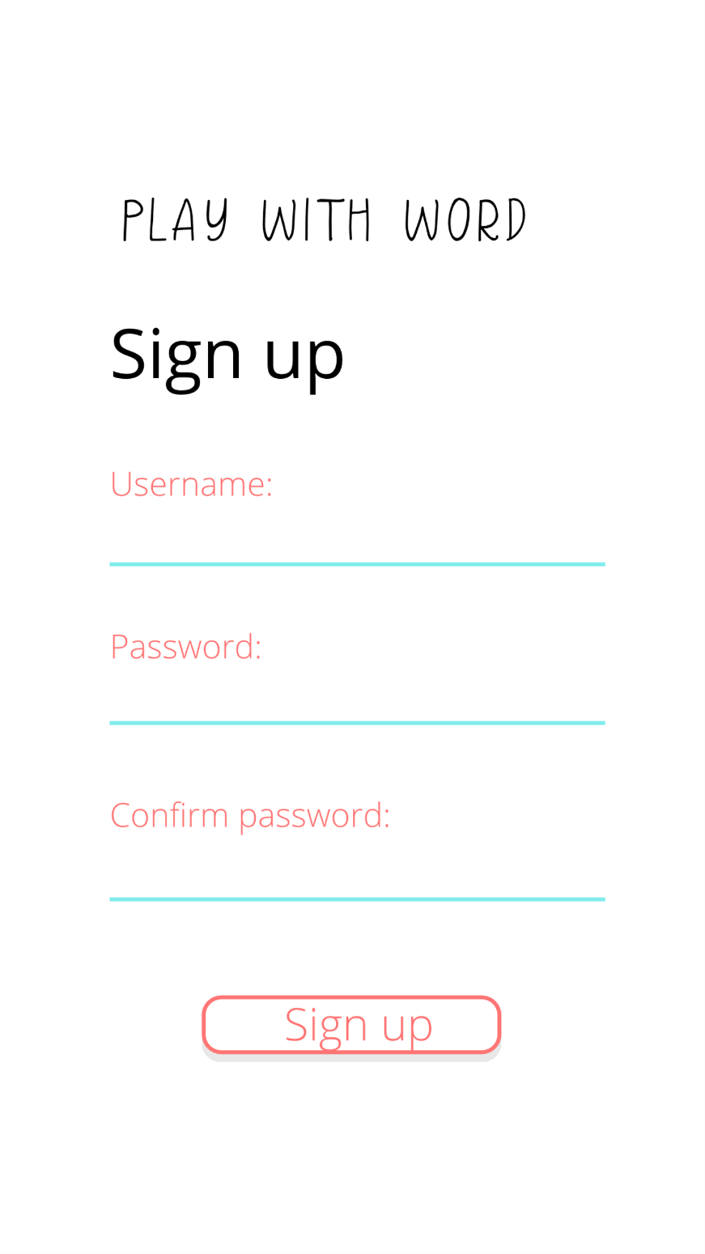



Sign in – Sign up
Success!
You have already Signed in.
Enjoyed our Game!
LET’S PLAY

Slide 6

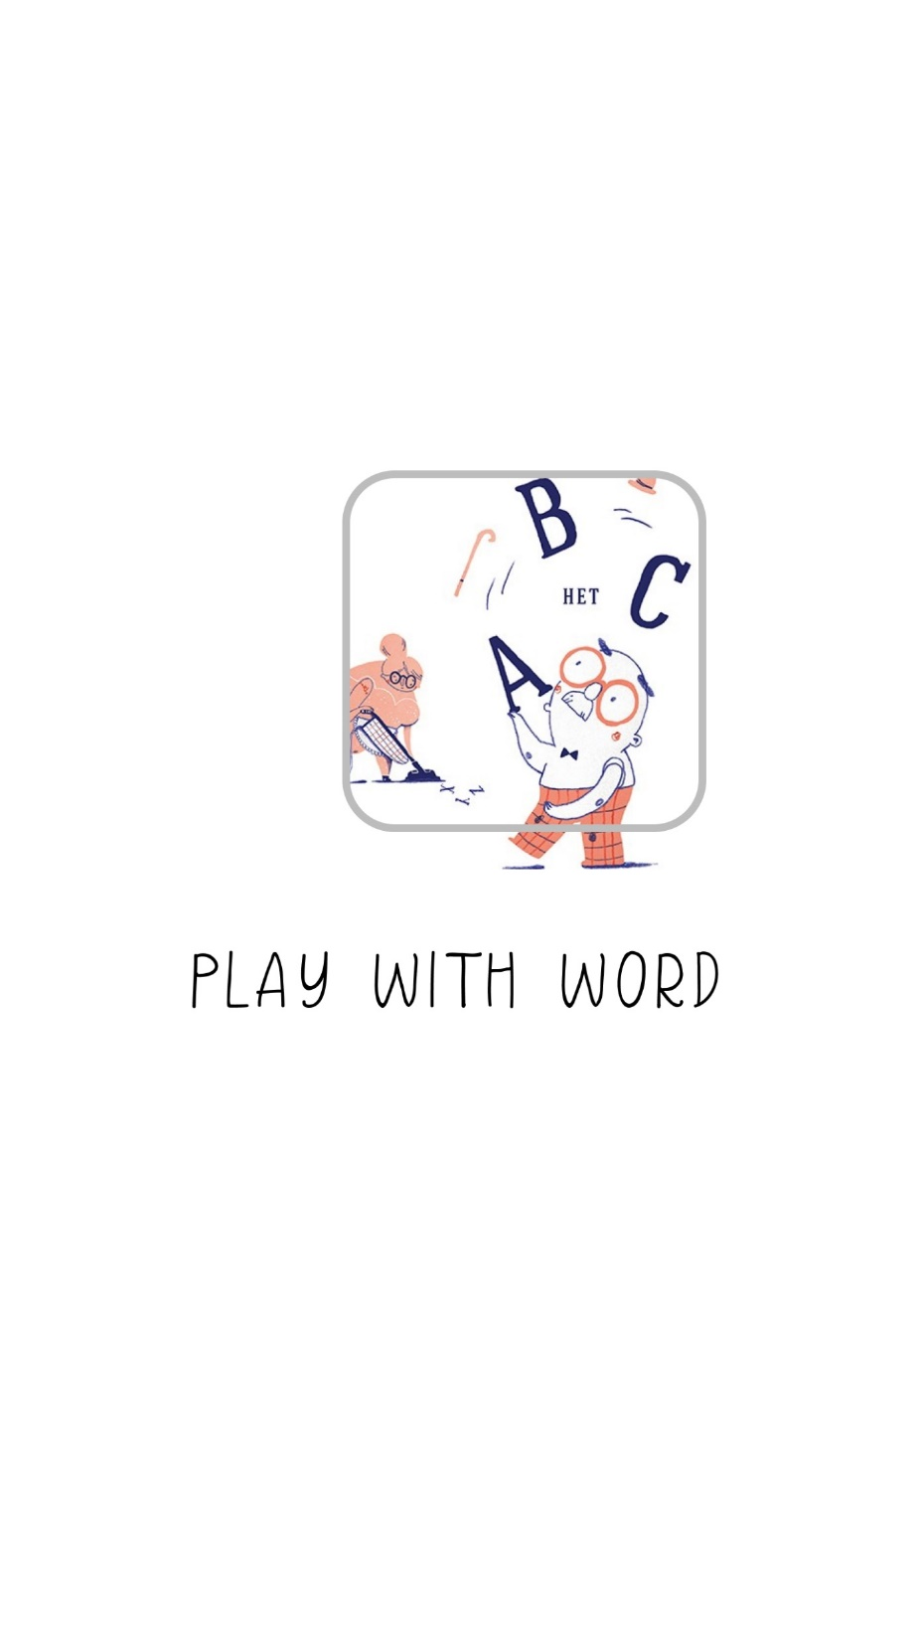

Slide 7
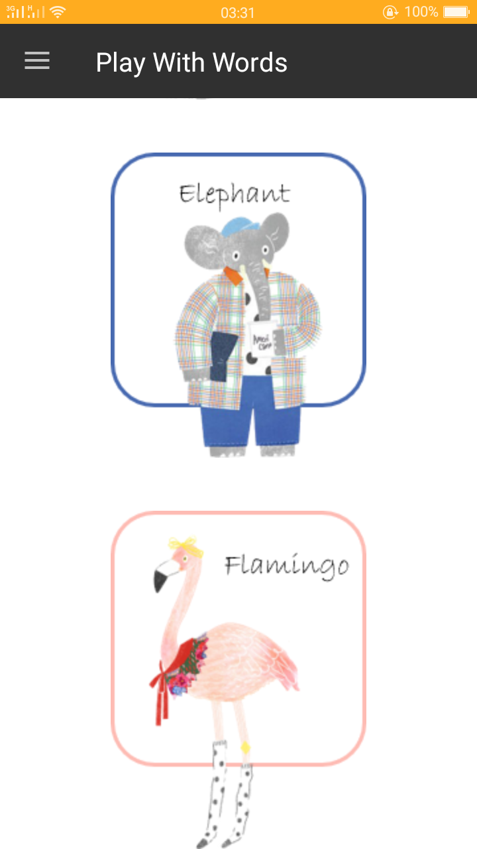
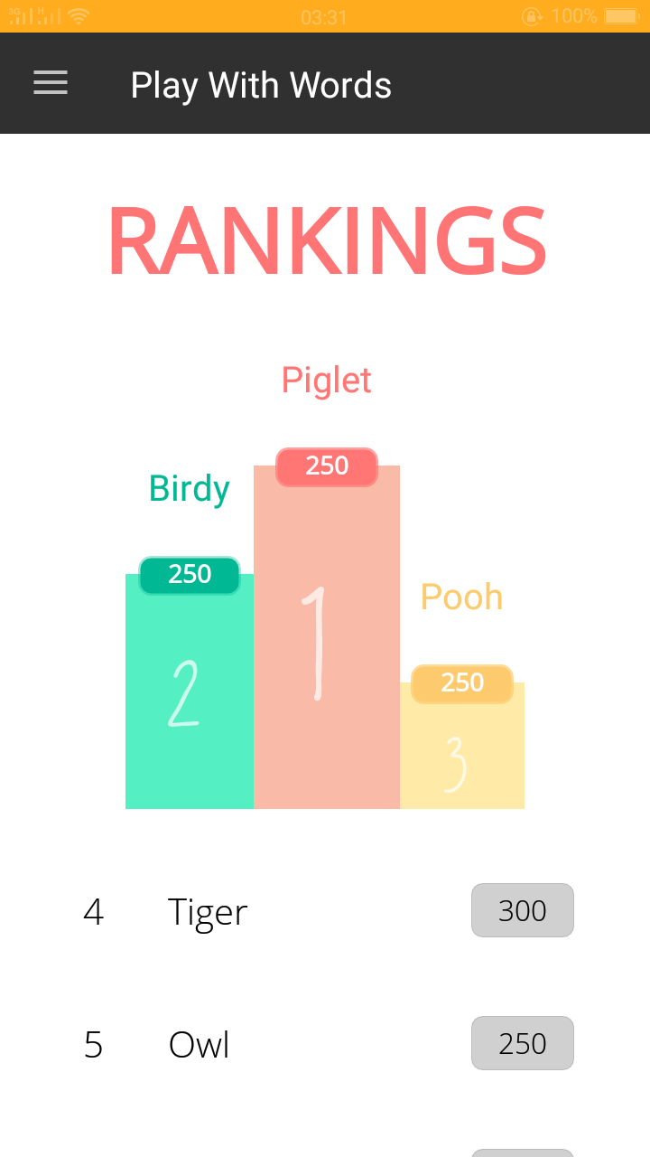
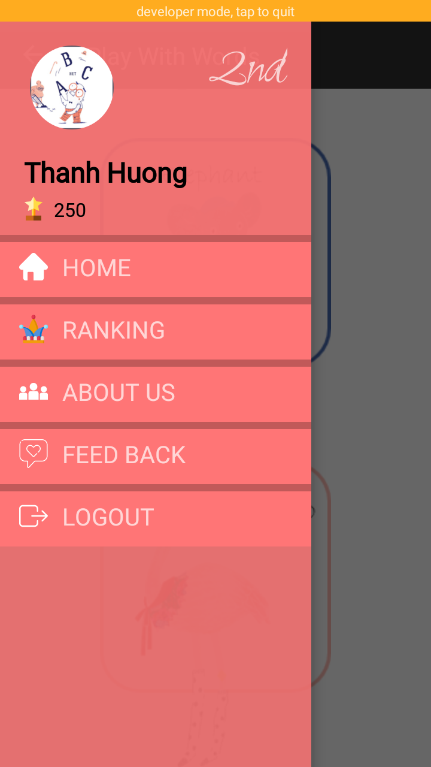
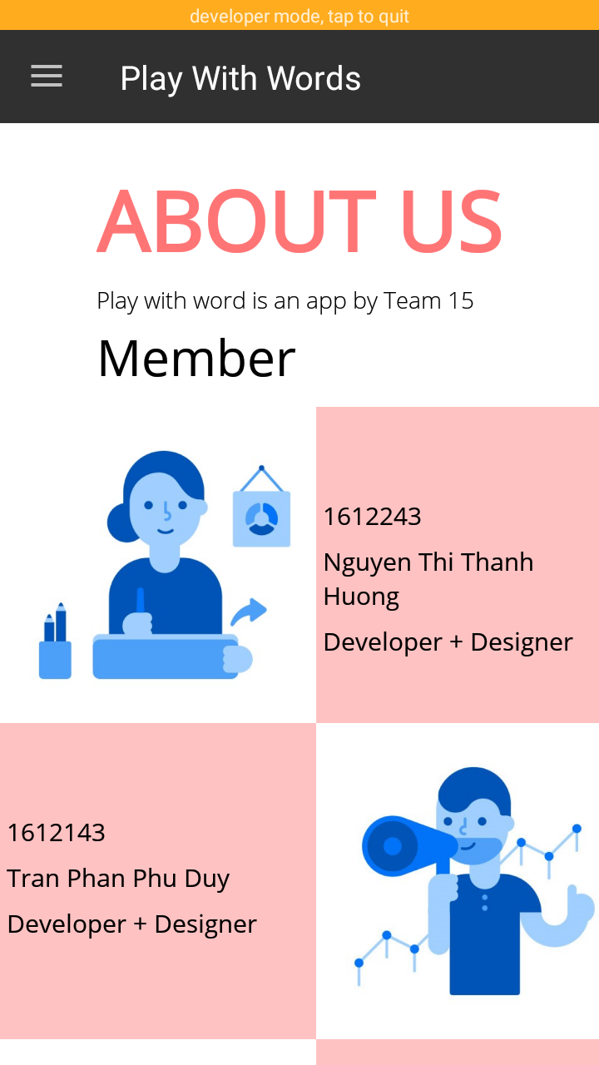
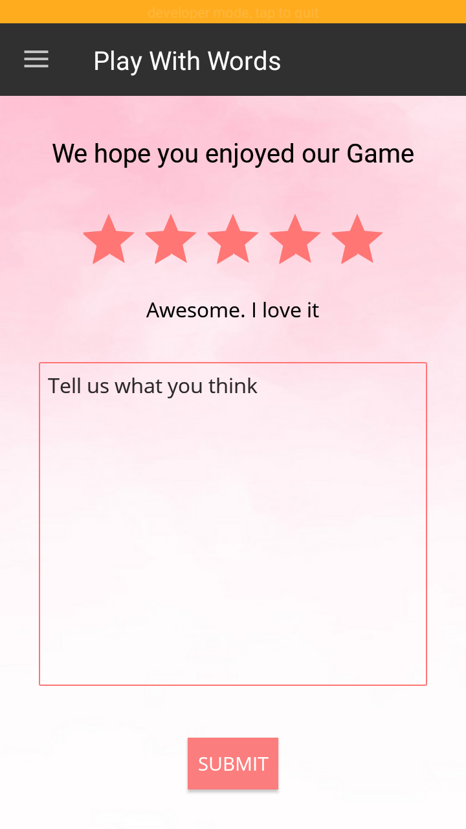
Menu

Slide 8
Library - Menu
Circle Image View
Component & Events
Recycler View
Circle Image View
Firebase-auth
Play-services-auth
Facebook-android
ProgressBar
Text View
Button Volume
Edit Text
Button Done
Hint
Point
Recycler View
Sign in
Google
Facebook

Slide 9







Slide 10
Mode 1
How to play
Choose one of the four options that describes the giving word in Vietnamese

Slide 11
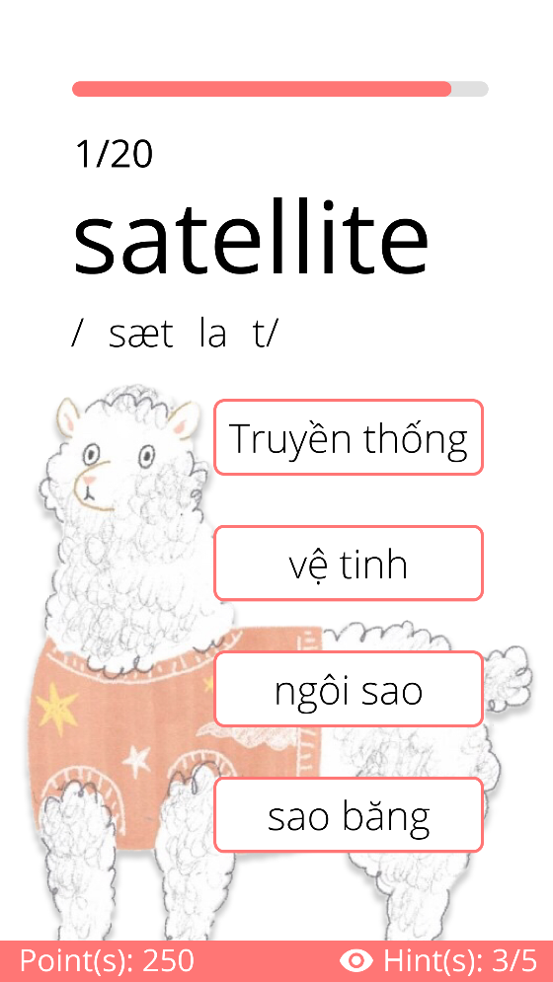
User Interface
Progress Bar
Round
TextView
Answer Button
Point
Hint

Slide 12



Components
And
Events
1/20
satellite
Progress Bar
Text View
4 Buttons
Hint
Point
/ˈsætəlaɪt/
Truyền thống
Truyền thống
Vệ tinh
Vệ tinh
Ngôi sao
Sao băng
Point(s): 250
Hint: 3/5

Slide 13
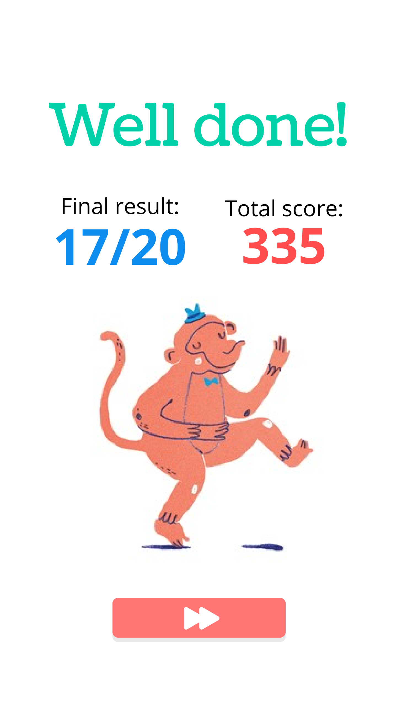
Components
And
Events
Component & Events
1/20
satellite
Progress Bar
Text View
4 Buttons
Hint
Point
ProgressBar
Text View
Button Volume
Edit Text
Button Done
Hint
Point
/ˈsætəlaɪt/
Truyền thống
Vệ tinh
Ngôi sao
Sao băng
Point(s): 250
Hint: 3/5

Slide 14

Mode 2
How to play
Choose one of the four options
that describes the giving
Picture in English

Slide 15
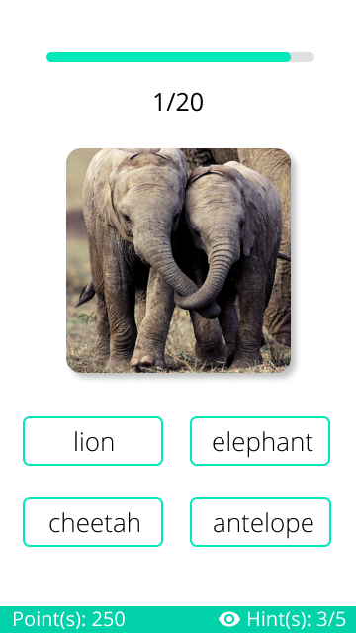
User Interface
ProgressBar
Round
ImageView
Button Choose the answer
Point
Hint

Slide 16
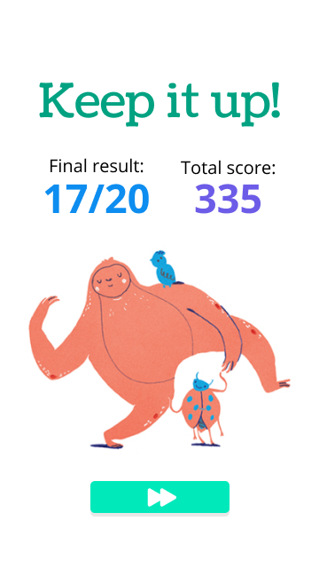


Component
And
Events
1/20
Progress Bar
Text View
Image View
Button Choose
Hint
Point
Lion
Elephant
Cheetah
Antelope
Point(s): 250
Hint: 3/5

Slide 17

Mode 3
How to play
Fill in the blank with a suitable word that matches the giving definition

Slide 18
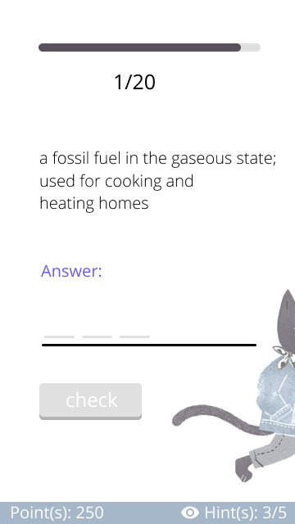
User Interface
Progress Bar
Round
Text View
Edit Text
Button
Point
Hint

Slide 19
Component
And
Events
1/20
A fossil fuel in the gaseous state;
used for cooking and
heating homes
Progress Bar
Text View
Edit Text
Button Check
Hint
Point
Answer:
C
o
Check
Point(s): 250
Hint: 3/5

Slide 20

Component
And
Events
1/20
A fossil fuel in the gaseous state;
used for cooking and
heating homes
Progress Bar
Text View
Edit Text
Button Check
Hint
Point
Answer:
C
o
a
l
Check
Point(s): 250
Hint: 3/5

Slide 21

Mode 4
How to play
Listen carefully
and write down the word.
Press DONE button to finish the task.

Slide 22
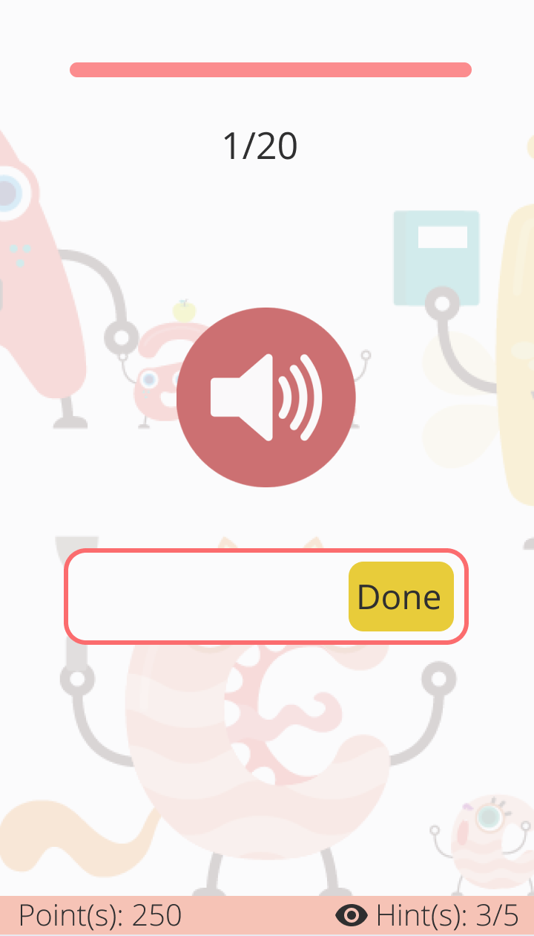
User Interface
Progress Bar
Round
Button volume
Edit Text
Button Done
Point
Hint

Slide 23


Component
And
Events
Component & Events
1/20
Progress Bar
Text View
Button Volume
Edit Text
Button Done
Hint
Point
ProgressBar
Text View
Button Volume
Edit Text
Button Done
Hint
Point
M
i
Done
Point(s): 250
Hint: 3/5

Slide 24
Component
And
Events
1/20
Progress Bar
Text View
Button Volume
Edit Text
Button Done
Hint
Point
Your Answer
Milk
Done
Point(s): 250
Hint: 3/5

Slide 25
Mode 5
How to play
By putting words in the right order, form a suitable sentence that has the giving Vietnamese meaning

Slide 26
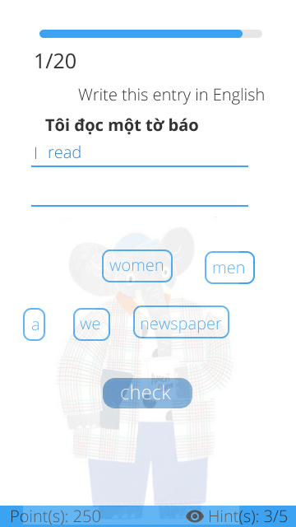
User Interface
Round
ProgressBar
Edit Text
Button
Point
Hint

Slide 27

Component
And
Events
1/20
Write this Entry in English
Chúng tôi đọc một tờ báo
Progress Bar
Text View
Text Box
Button Word
Button Check
Hint
Point
read
women
men
a
we
newspaper
Check
Point(s): 250
Hint: 3/5

Slide 28
Component
And
Events
1/20
Write this Entry in English
Chúng tôi đọc một tờ báo
Progress Bar
Text View
Text Box
Button Word
Button Check
Hint
Point
read
women
men
a
we
newspaper
Check
Point(s): 250
Hint: 3/5

Slide 29


Mode 6
How to play
Speak out the giving word
Hold to record your voice

Slide 30
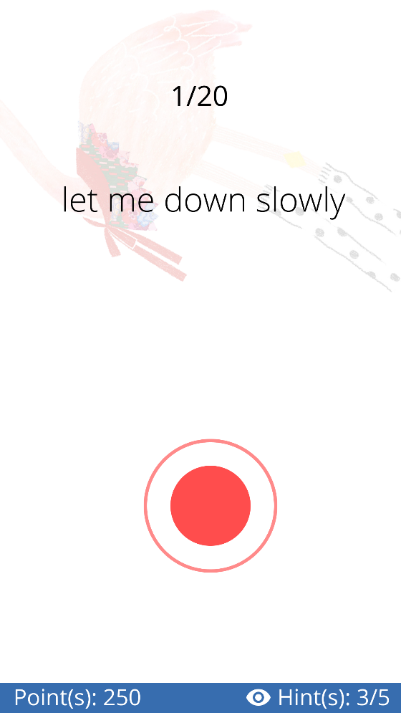
User Interface
Round
Text View For Question
Record
Point
Hint

Slide 31


Component
And
Events
1/20
Let me down slowly
Progress Bar
Text View
Button Record
Hint
Point
You read exactly 95%
Point(s): 250
Hint: 3/5

Slide 32
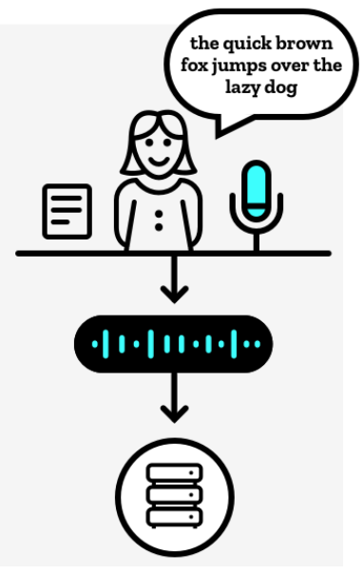
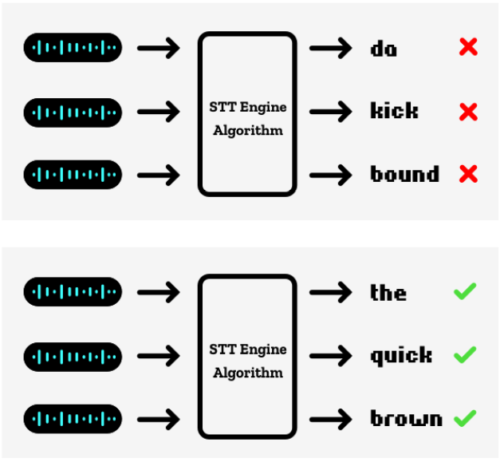
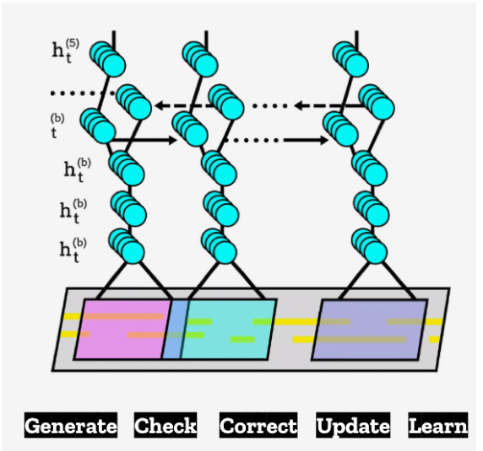
How a Speech To Text In Machine Learning
Step 1:Record voices
Step 2. Input voice data
Step 3. Train the speech algorithm

Slide 33
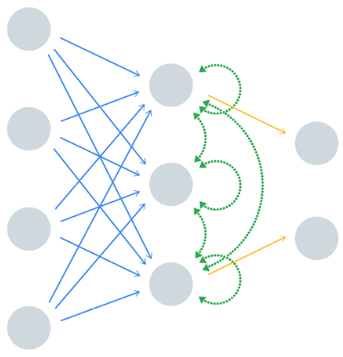

How to exchange Text to Speech using Neural Network
Convert Text to vector for Neural Network
Input Text
Text To Speech

Slide 34

Database
getValue
getValue
setValue

Slide 35

Using point to buy hint
Opps : (
Points (1 mode)
Number Of Hint
Points ≥ 7
Sorry!
You don’t have enough point to buy hint.
Just 7 points for 1 hint.
Do you ready want to buy more hint?
Oh, you’re almost out of hint.
Use your point to get more hint. just 7 points for 1 hint
The user can use point to buy hint
Update Points & Number hint
Number Of Hint = 0
OKE
OKE
CANCEL
Never show again
GOT IT

Slide 36
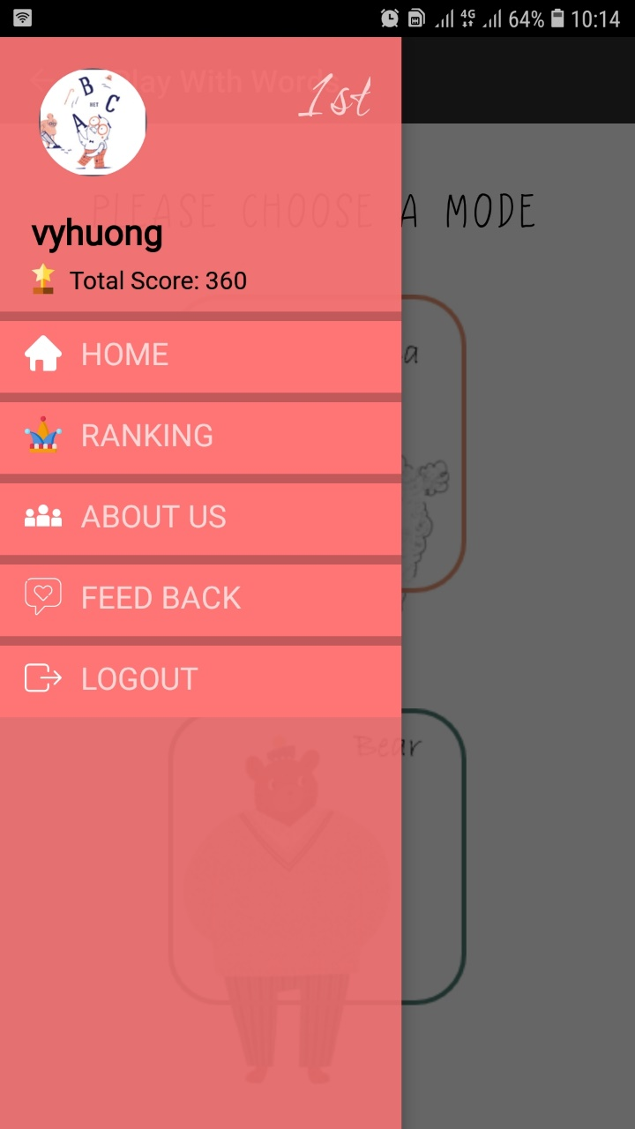
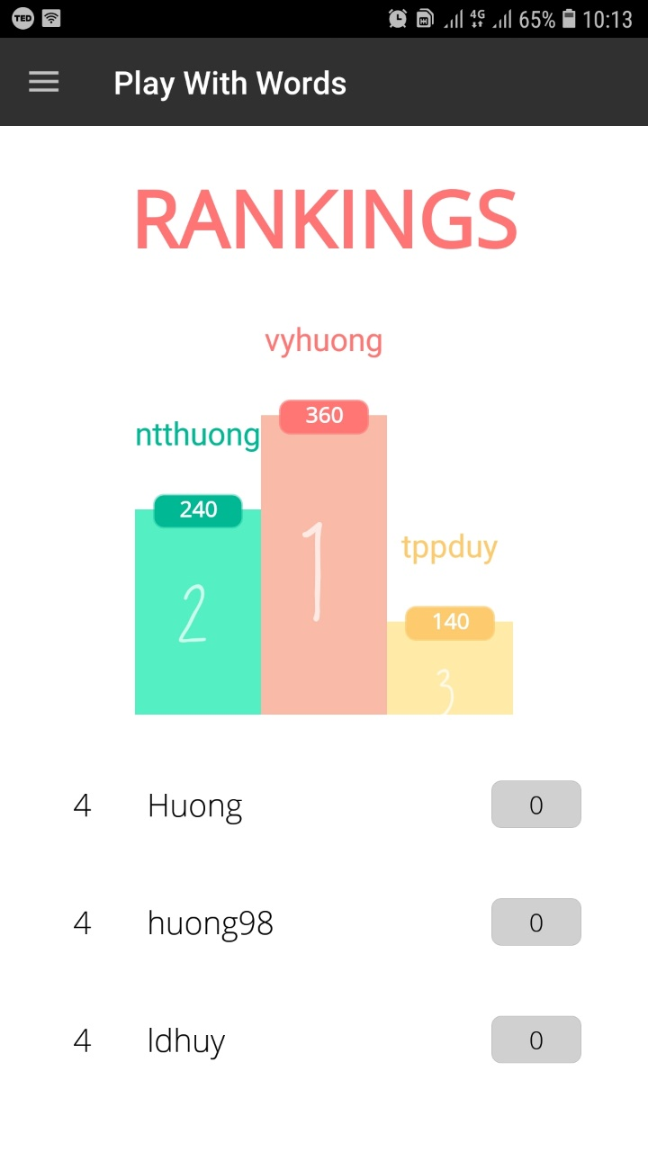
Using point to rank
private class User
{
private String name;
private long totalScore;
}
List<User> mUser = new ArrayList<>( );
Reading a list of user’s information from Firebase and assign to mUser.
Sorting mUser in descending order by totalScore.
Finding index of user in mUser and assign to index.
We can find the order of user’s rank according to index.
According to sorted mUser list.
Picking first 3 users in mUser (3 users have highest score) and set to raking chart.
Picking next 7 users to set to the list below.
If the number of user in mUser list is not enough to set, we will set “…” to the blank.

Slide 37


Effects
Background Music
Gif Image
Button notification right/wrong
Sound notification right/wrong
RippleBackground
com.skyfishjy.library

Slide 38




Share result
Share
Menu

Slide 39


Log out
Do you want to quit?
OKE
NO

Slide 40
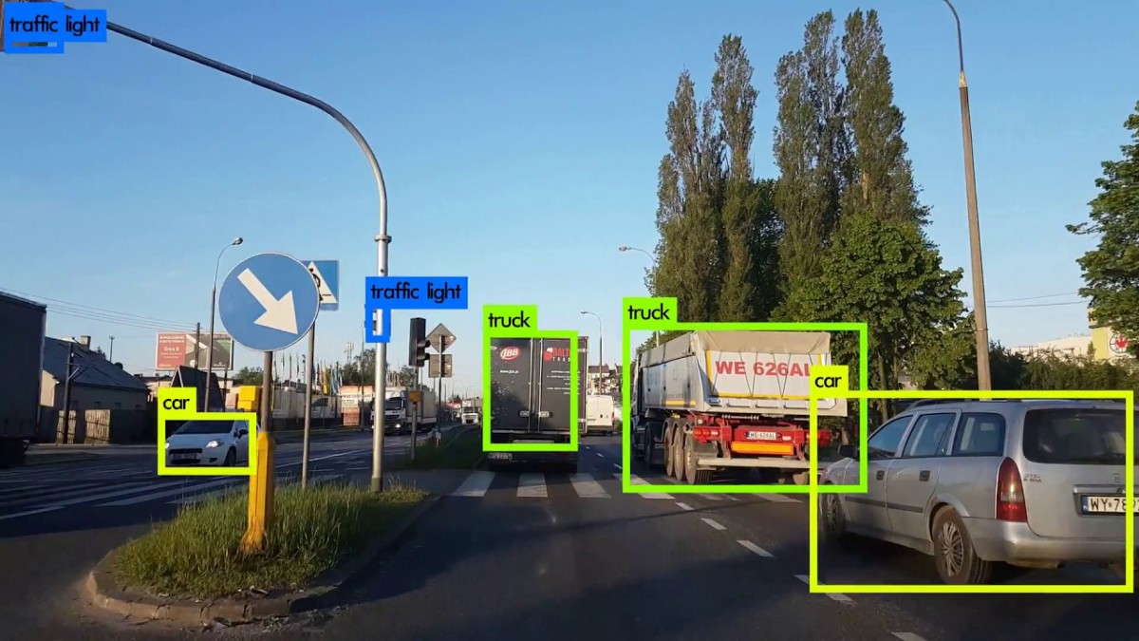
Extend “Learning English With Real Life”

Slide 41

Extend “Learning English with real Life”
Coming soon

Slide 42


Play with words
THANK YOU

